Slide 1
Brief review of my research programs for General Fusion
Xinhang Xu
PhD USTC (2016-2023)
Postdoc UC Davis (2024-Present)

Slide 2
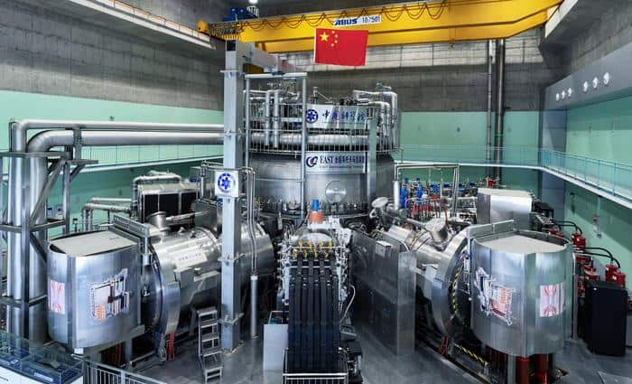
Work Experience:
EAST : ECEI & MIR development, operation, and data analysis; (2016-2023)
DIII-D: ECEI synthetic diagnostic model development and ECEI data analysis;(2024-Present)
NSTX-U: High-k scattering diagnostics and FIReTIP laser development with laboratory testing;(2024-Present)

Slide 3
If I were to take this position, what expectations would you have for me by the end of the year?

Slide 4
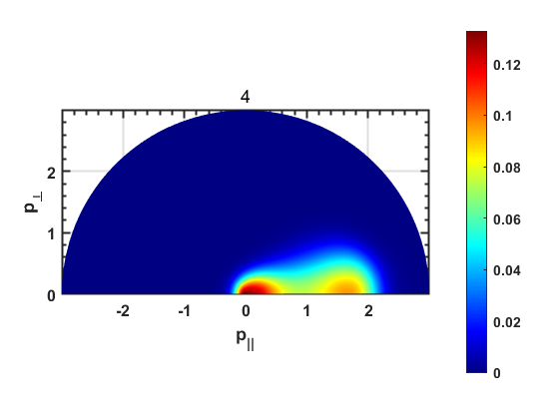
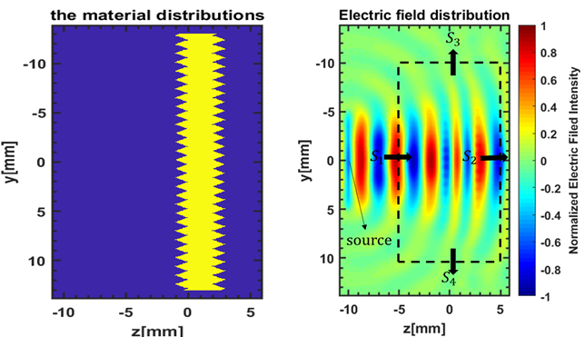
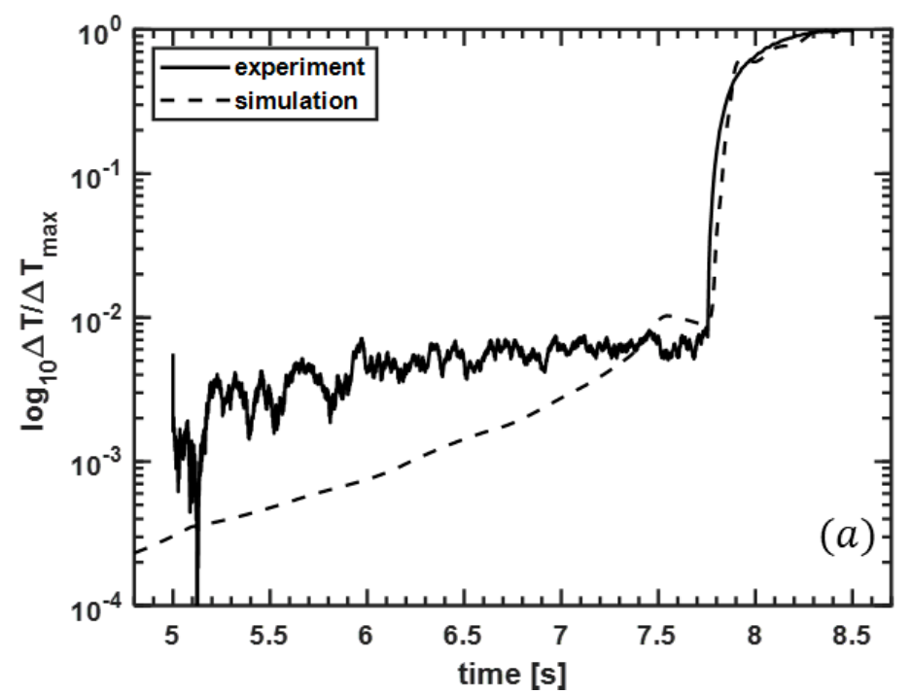
Works on simulations (During PHD at USTC)
From 2016-2023
Fork-plank Simulation
3D-ray tracing simulation
2D FDTD simulation
Synthetic Diagnostic
Mainly developed on MATLAB

Slide 5
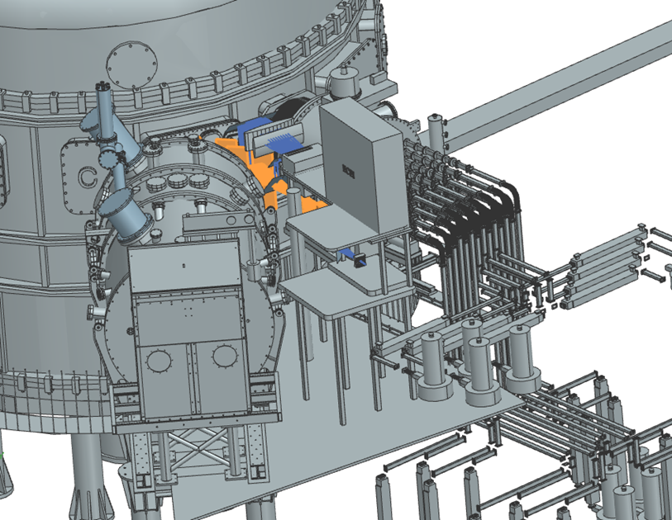
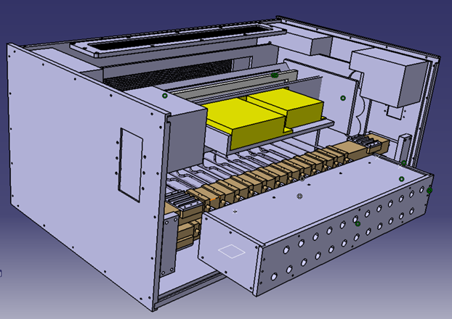
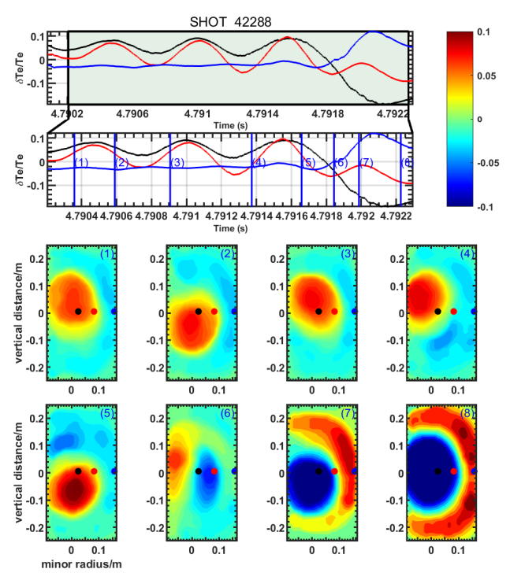
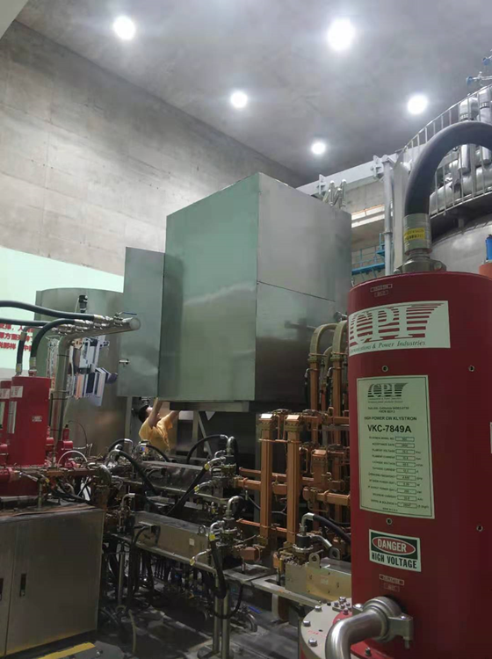
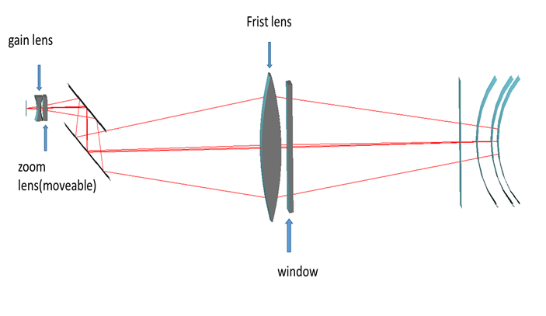
Works on Experiment (During PHD at USTC)
From 2016-2023
Design ECEI antenna Shielding
Design ECEI&MIR platform
Optical Design
Experiment data analysis
COMSOL Multiphysics, Catia, Code V

Slide 6
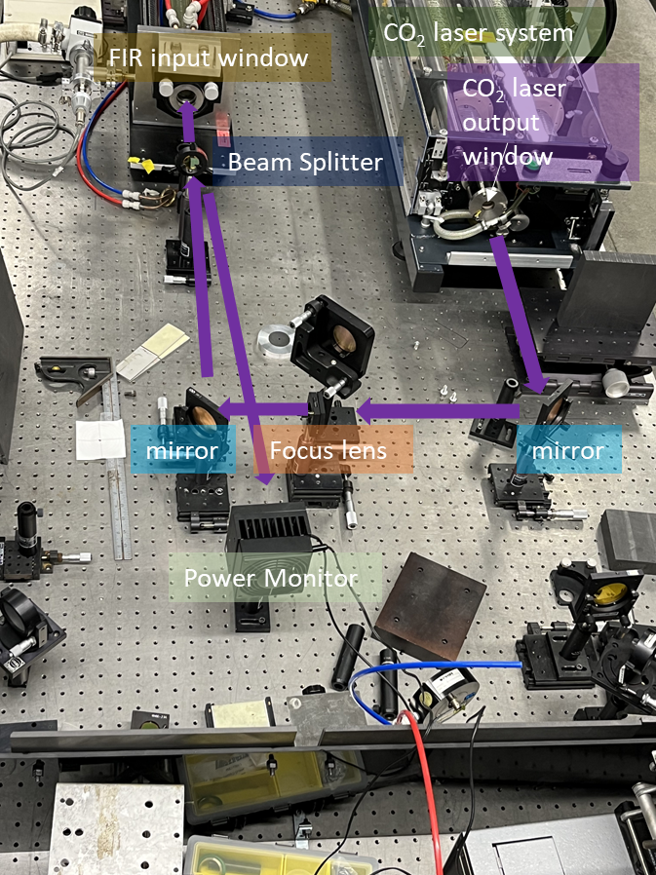
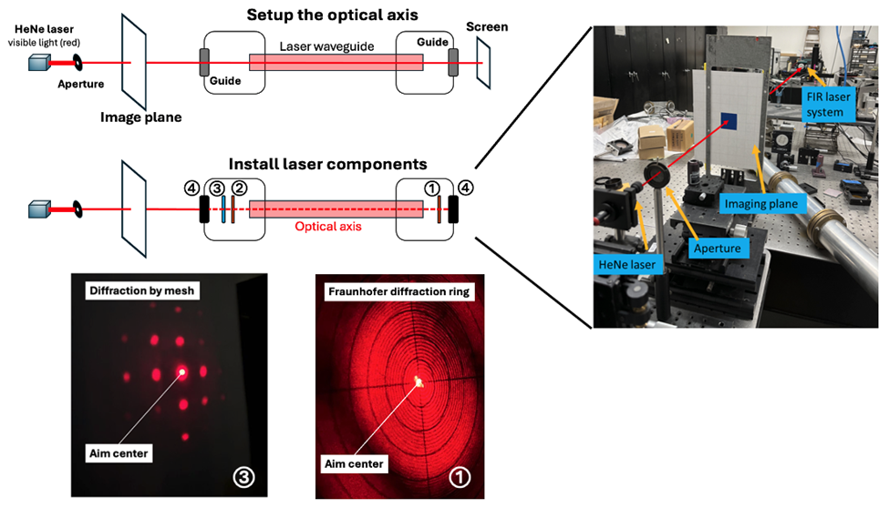
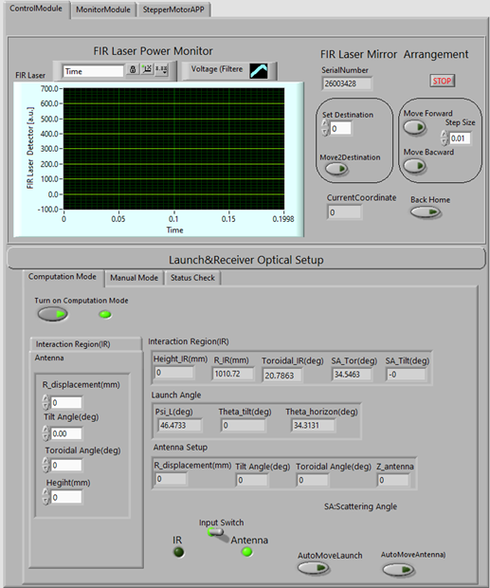
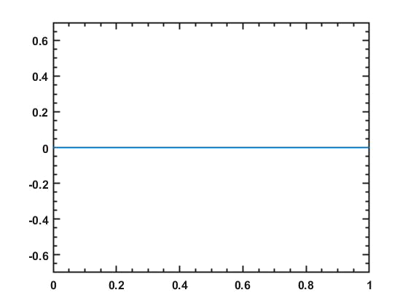
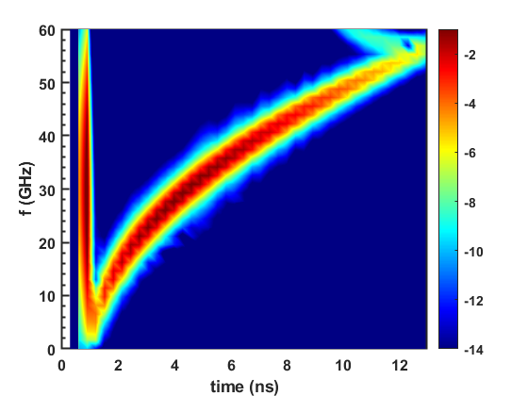
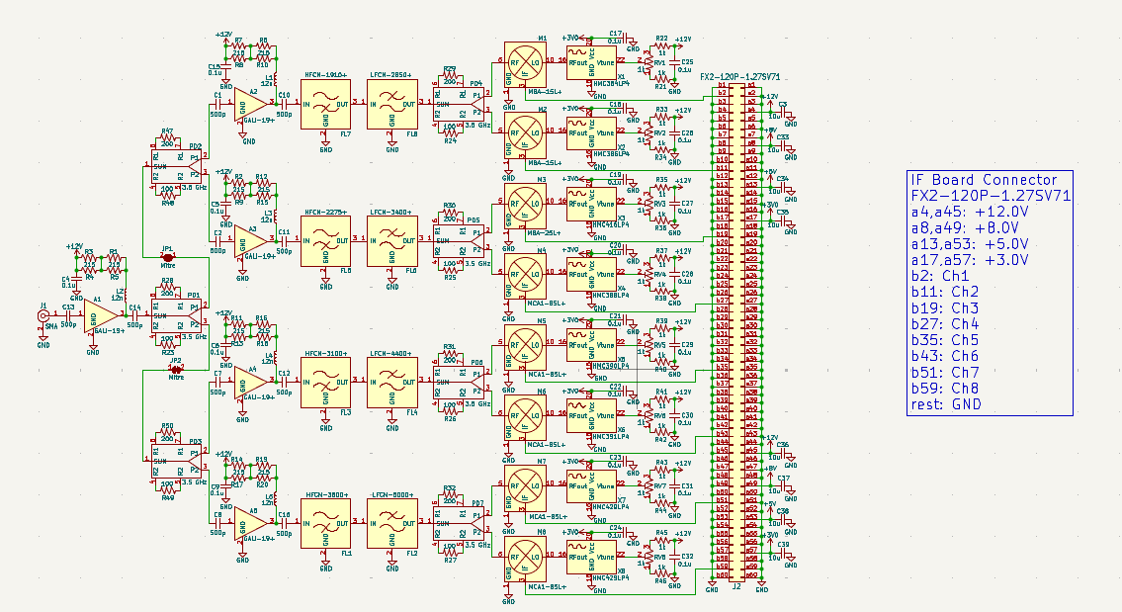
Works during Postdoc at UC Davis
From 2024-2025
High-k scattering laser design for NSTX-U
FIReTIP laser design for PPPL
1D FDTD simulation in plasma
RF board design for CTS on BEST
Ultra Short Plus Reflectometry simulation
E
z/m
Software: KiCAD, Python, LabVIEW

